Slide 1


SMART INDIA HACKATHON 2025
TITLE PAGE
Problem Statement ID –SIH25048
Problem Statement Title- Gamified Learning Platform for Rural Education.
Theme-Smart Education
PS Category- Software
Team ID-
Team Name (Registered on portal)-Techbirds

Slide 2
Technifly Dive into smart education
Techbirds
The website will have an RPG(Role-Playing Game) game-like interface where learning is organized into levels which will be education oriented and will be available in multilanguages.
We will try to make it available offline and deployable to low cost devices to overcome technical barriers.
Each topic starts with an introduction to advance followed by interactive games such as quizzes, puzzles, and matching exercises that include answers and explanations.
Learners earn experience points (XP) for completing topics , and upon finishing a topic without cheating(skipping topics), then only they can receive cool badges like for example - “Algebra Wizard” or “ Algebra Slayer.”
A streak system motivates daily learning by sending reminders via notifications.
This gamified approach makes learning fun and engaging, encouraging students to spend more time on the platform.
Badges and streaks help track progress and motivate continued learning without complicated systems.
The idea innovatively combines gamification, multilingual content, and offline access aimed at rural students with limited internet—making STEM education more accessible and effective.
It supports learners and teachers by promoting engagement and enabling progress tracking in resource-limited settings.
.

Slide 3
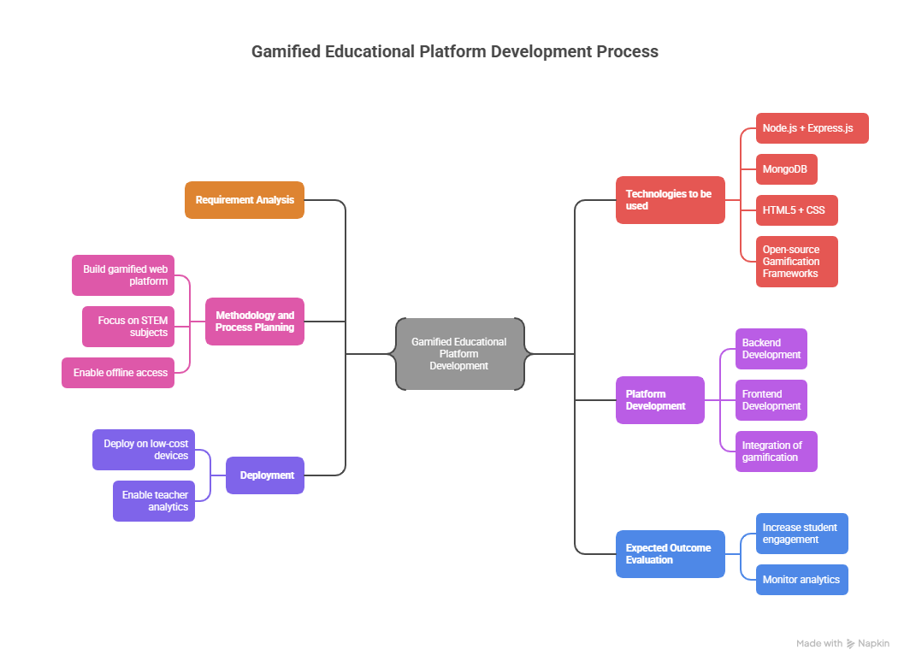
TECHNICAL APPROACH
Techbirds

Slide 4
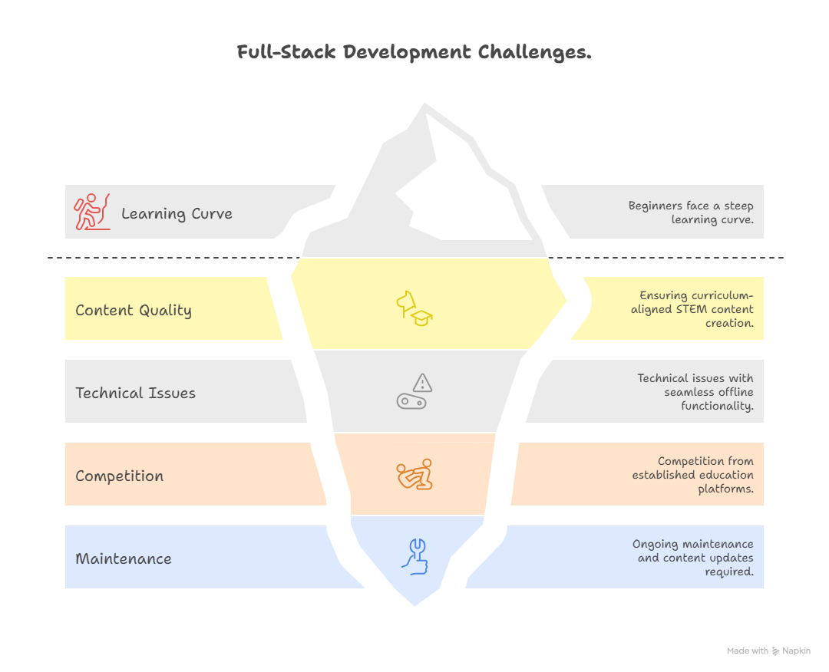
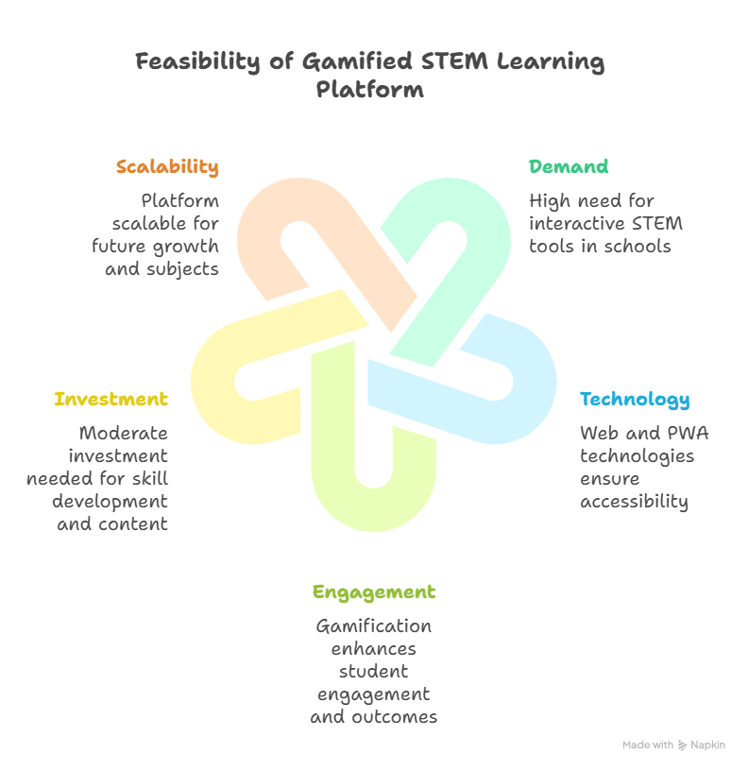
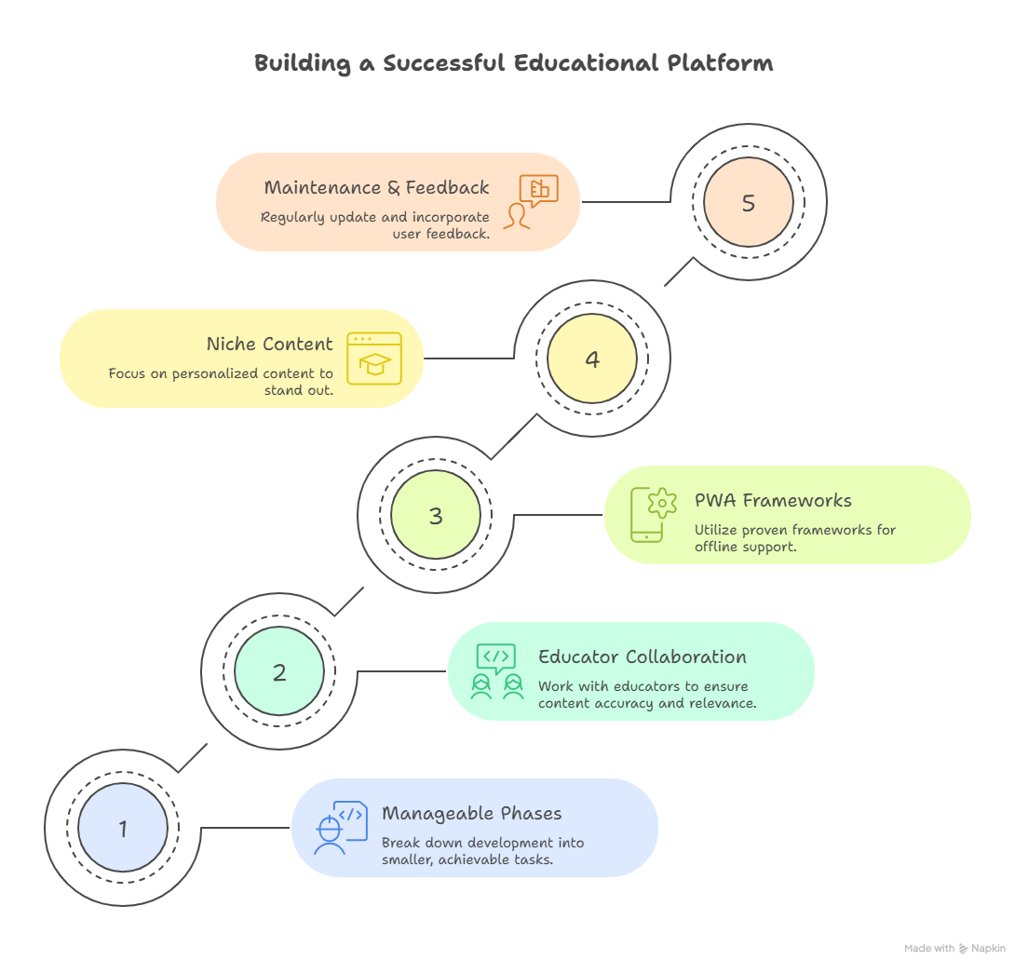
FEASIBILITY AND VIABILITY
Techbirds

Slide 5
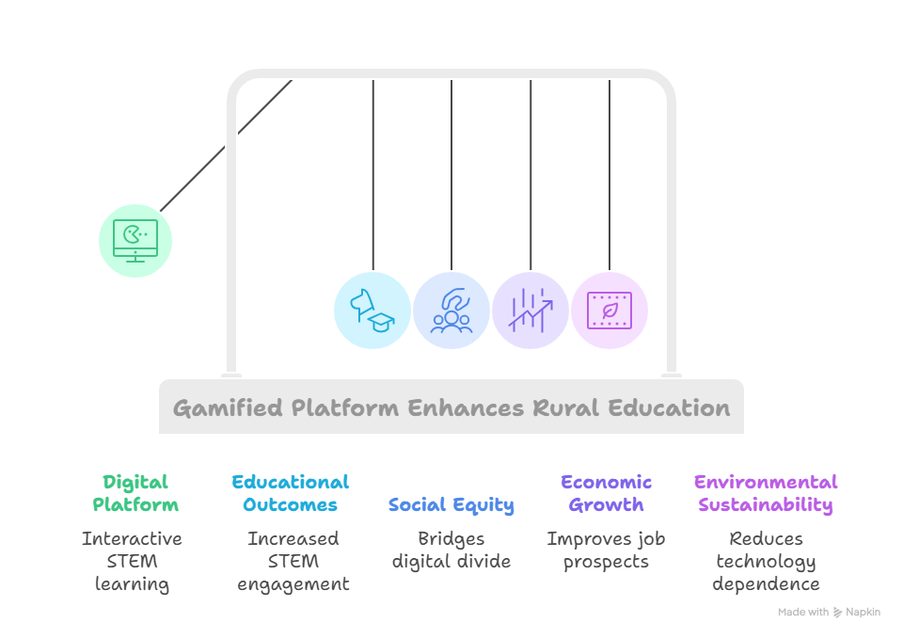
IMPACT AND BENEFITS
Techbirds
Potential impact on the target audience-Educational impact,
Benefits of the solution (social, economic, environmental, etc.)

Slide 6
RESEARCH AND REFERENCES
Techbirds
Details / Links of the reference and research work-
https://coddy.tech/ -reference site
Mostly research-work is done by using Perplexity and Chatgpt.

